Slide 1
DISPERSION
@Statistics
#Data Science

Slide 2
Dispersion
Dispersion in statistics is a way of describing how spread out a set of data is.
When a data set has a large value, the values in the set are widely scattered;
when it is small the items in the set are tightly clustered. Very basically, this set of data has a small value: 1, 2, 2, 3, 3, 4
…and this set has a wider one:
0, 1, 20, 30, 40, 100

Slide 3
Percentile: The value below which a percentage of data falls.
Calculating Percentile
SCORE RANK
30 1
33 2
43 3
53 4
56 5
67 6
68 7
72 8
Sample question: Find out where the 25th percentile is in the above list.
Step 1: Calculate what rank is at the 25th percentile. Use the following formula:
Percentile / 100 * (number of items + 1)
25 / 100 * (8 + 1) = 0.25 * 9 = 2.25.
A rank of 2.25 is at the 25th percentile. However, there isn’t a rank of 2.25
so you must either round up, or round down. As 2.25 is closer to 2 than 3, I’m going to round down to a rank of 2.
Step 2: Choose either definition 1 or 2:
Definition 1: The lowest score that is greater than 25% of the scores. That equals a score of 43 on this list (a rank of 3).
Definition 2: The smallest score that is greater than or equal to 25% of the scores. That equals a score of 33 on this list (a rank of 2).
Depending on which definition you use, the 25th percentile could be reported at 33 or 43! A third definition attempts to correct this possible misinterpretation:
Definition 3: A weighted mean of the percentiles from the first two definitions.

Slide 4
In the above example, here’s how the percentile would be worked out using the weighted mean:
Multiply the difference between the scores by 0.25 (the fraction of the rank we calculated above). The scores were 43 and 33, giving us a difference of 10:
(0.25)(43 – 33) = 2.5
Add the result to the lower score. 2.5 + 33 = 35.5
In this case, the 25th percentile score is 35.5, which makes more sense as it’s in the middle of 43 and 33.

Slide 5
Quartiles
In statistics, Quartiles are the set of values which has three points dividing the data set into four identical parts.
Quartiles divide the entire set into four equal parts. So, there are three quartiles, first, second and third represented by Q₁, Q₂ and Q₃, respectively.
Q₂ is nothing but the median, since it indicates the position of the item in the list and thus, is a positional average.

Slide 6
Quartiles Formula
Suppose, Q₃ is the upper quartile is the median of the upper half of the data set. Whereas, Q₁ is the lower quartile and median of the lower half of the data set. Q₂ is the median. Consider, we have n number of items in a data set. Then the quartiles are given by;
Q₁ = [(n+1)/4]th item
Q₂ = [(n+1)/2]th item
Q₃ = [3(n+1)/4]th item

Slide 7
Quartiles in Statistics
Similar to the median which divides the data into half so that 50% of the estimation lies below the median and 50% lies above it, the quartile splits the data into quarters so that 25% of the estimation are less than the lower quartile, 50% of estimation are less than the mean, and 75% of estimation are less than the upper quartile. Usually, the data is ordered from smallest to largest:
First quartile: 25% from smallest to largest of numbers
Second quartile: between 25.1% and 50% (till median)
Third quartile: 51% to 75% (above the median)
Fourth quartile: 25% of largest numbers

Slide 8
Interquartile Range
The interquartile range (IQR) is the difference between the upper and lower quartile of a given data set and is also called a mid-spread. It is a measure of statistical distribution, which is equal to the difference between the upper and lower quartiles. Also, it is a calculation of variation while dividing a data set into quartiles. If Q1 is the first quartile and Q3 is the third quartile, then the IQR formula is given by;
IQR = Q3 – Q1

Slide 9
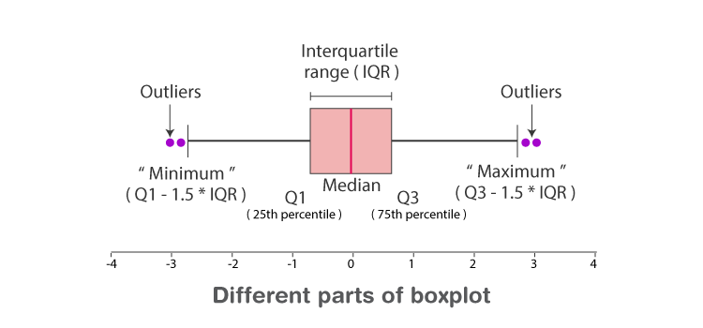
Find the quartiles of the following data: 4, 6, 7, 8, 10, 23, 34.
Solution: Here the numbers are arranged in the ascending order and number of items, n = 7
Lower quartile, Q₁ = [(n+1)/4] th item
Q₁= 7+1/4 = 2nd item = 6
Median, Q₂ = [(n+1)/2]th item
Q₂= 7+1/2 item = 4th item = 8
Upper Quartile, Q₃ = [3(n+1)/4]th item
Q₃ = 3(7+1)/4 item = 6th item = 23

Slide 10
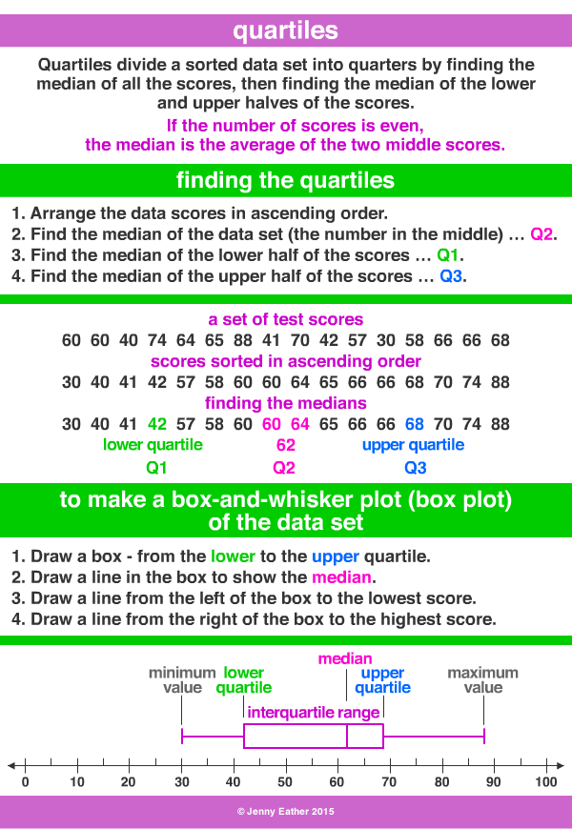

Slide 11

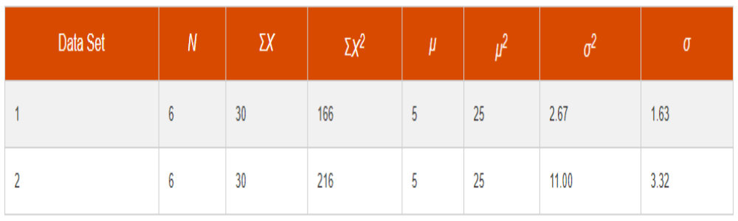
Variance and Standard Deviation
Variance :
Standard Deviation : √ Variance = √ =
data set 1: 3, 4, 4, 5, 6, 8
data set 2: 1, 2, 4, 5, 7, 11 .

Slide 12
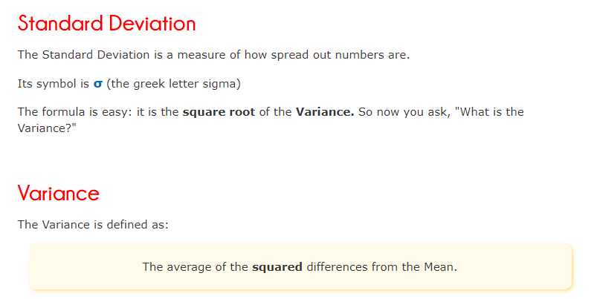
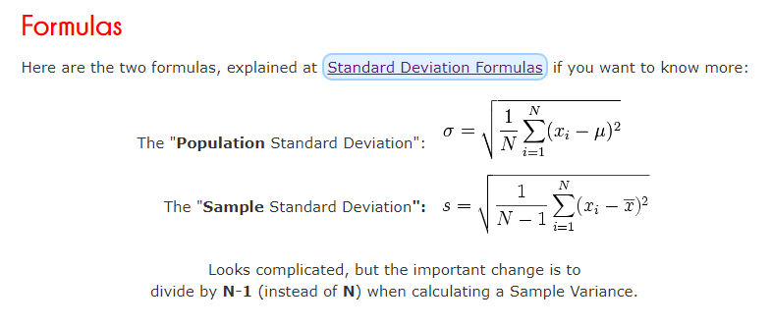

Slide 13
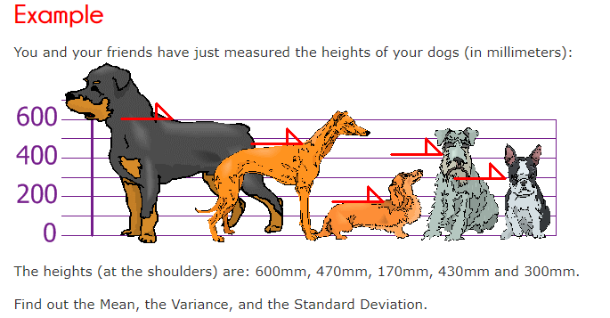
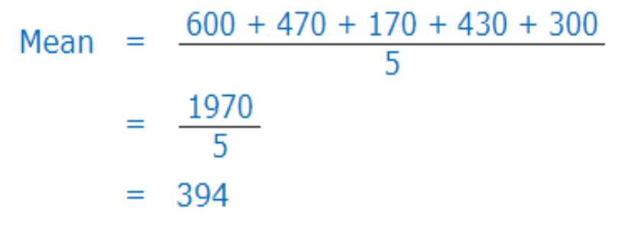
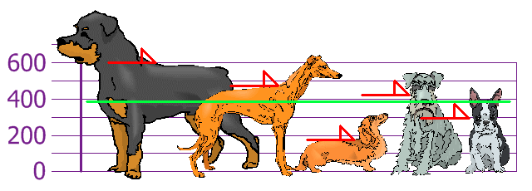

Slide 14
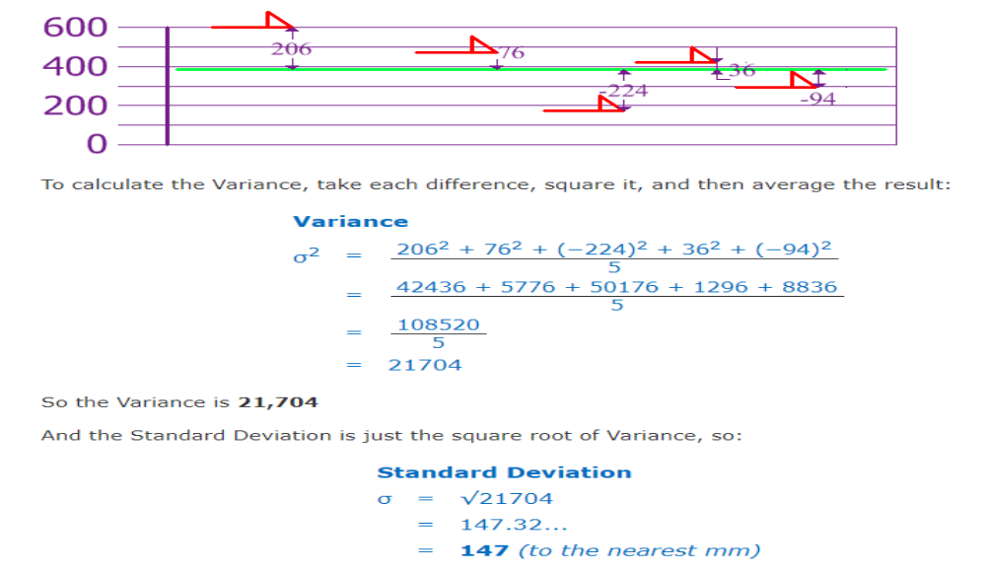
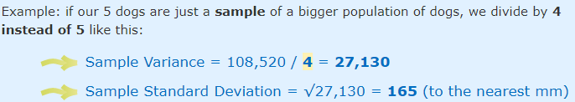

Slide 15
import numpy as np
x = np.arange(6)
print("\nOriginal array:")
print(x)
r1 = np.mean(x)
r2 = np.average(x)
print("\nMean: ", r1)
print("\nMean: ", r2)
r1 = np.std(x)
r2 = np.sqrt(np.mean((x - np.mean(x)) ** 2 ))
print("\nstd: ", r1)
print("\nstd: ", r2)
r1= np.var(x)
r2 = np.mean((x - np.mean(x)) ** 2 )
print("\nvariance: ", r1)
print("\nvariance: ", r2)

Slide 16
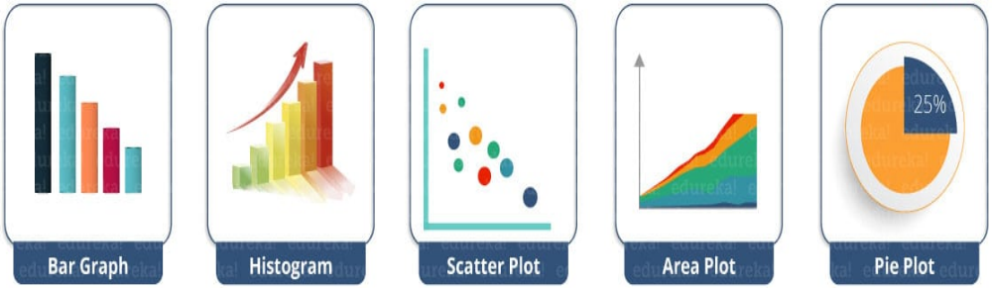
matplotlib.pyplot is a plotting library used for 2D graphics in python programming language. It can be used in python scripts, shell, web application servers and other graphical user interface toolkits.

Slide 17
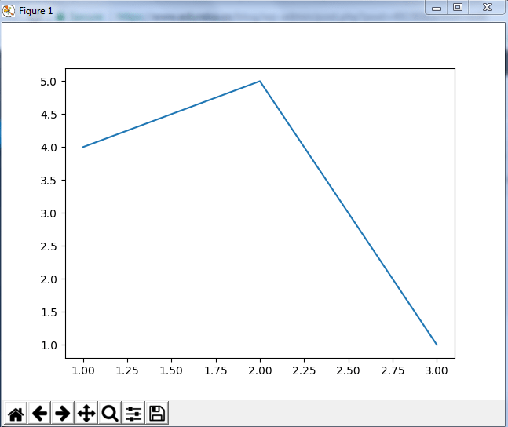
from matplotlib import pyplot as plt
#Plotting to our canvas
plt.plot([1,2,3],[4,5,1])
#Showing what we plotted
plt.show()

Slide 18
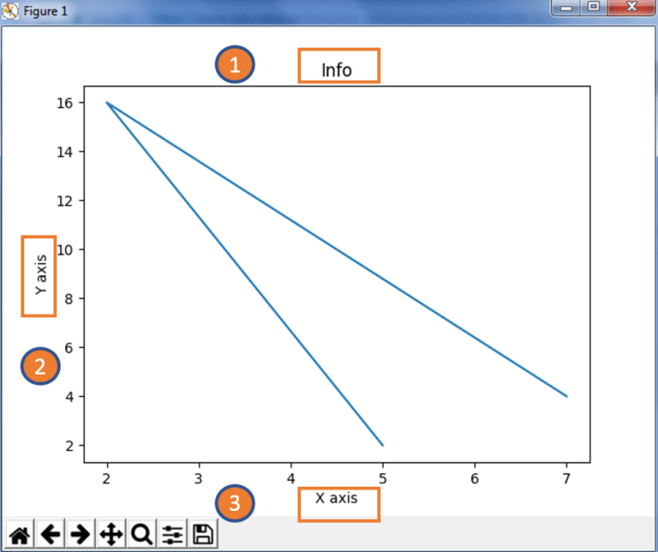
from matplotlib import pyplot as plt
x = [5,2,7]
y = [2,16,4]
plt.plot(x,y)
plt.title('Info')
plt.ylabel('Y axis')
plt.xlabel('X axis')
plt.show()

Slide 19
from matplotlib import pyplot as plt
from matplotlib import style
x = [5,8,10]
y = [12,16,6]
x2 = [6,9,11]
y2 = [6,15,7]
plt.plot(x,y,'g',label='line one', linewidth=5)
plt.plot(x2,y2,'c',label='line two',linewidth=5)
plt.title('Epic Info')
plt.ylabel('Y axis')
plt.xlabel('X axis')
plt.legend()
plt.grid(True,color='k')
plt.show()

Slide 20
Bar Graph
from matplotlib import pyplot as plt
plt.bar([0.25,1.25,2.25,3.25,4.25],[50,40,70,80,20],
label="BMW",width=.5)
plt.bar([.75,1.75,2.75,3.75,4.75],[80,20,20,50,60],
label="Audi", color='r',width=.5)
plt.legend()
plt.xlabel('Days')
plt.ylabel('Distance (kms)')
plt.title('Information')
plt.show()

Slide 21
Histogram
import matplotlib.pyplot as plt
population_age = [22,55,62,45,21,22,34,42,42,4,2,102,95,85,55,110,120,70,65,55,111,115,80,75,65,54,44,43,42,48]
bins = [0,10,20,30,40,50,60,70,80,90,100]
plt.hist(population_age, bins, histtype='bar', rwidth=0.8)
plt.xlabel('age groups')
plt.ylabel('Number of people')
plt.title('Histogram')
plt.show()
‘’’ bin refers to the range of values that are divided into series of intervals. Bins are usually created of the same size. In the below code, I have created the bins in the interval of 10 which means the first bin contains elements from 0 to 9, then 10 to 19 and so on.’’’

Slide 22
Scatter Plot
import matplotlib.pyplot as plt
x = [1,1.5,2,2.5,3,3.5,3.6]
y = [7.5,8,8.5,9,9.5,10,10.5]
x1=[8,8.5,9,9.5,10,10.5,11]
y1=[3,3.5,3.7,4,4.5,5,5.2]
plt.scatter(x,y, label='high income low saving',color='r')
plt.scatter(x1,y1,label='low income high savings',color='b')
plt.xlabel('saving*100')
plt.ylabel('income*1000')
plt.title('Scatter Plot')
plt.legend()
plt.show()

Slide 23
Area Plot
import matplotlib.pyplot as plt
days = [1,2,3,4,5]
sleeping =[7,8,6,11,7]
eating = [2,3,4,3,2]
working =[7,8,7,2,2]
playing = [8,5,7,8,13]
plt.plot([],[],color='m', label='Sleeping', linewidth=5)
plt.plot([],[],color='c', label='Eating', linewidth=5)
plt.plot([],[],color='r', label='Working', linewidth=5)
plt.plot([],[],color='k', label='Playing', linewidth=5)
plt.stackplot(days, sleeping,eating,working,playing, colors=['m','c','r','k'])
plt.xlabel('x')
plt.ylabel('y')
plt.title('Stack Plot')
plt.legend()
plt.show()

Slide 24
Pie Chart
import matplotlib.pyplot as plt
days = [1,2,3,4,5]
sleeping =[7,8,6,11,7]
eating = [2,3,4,3,2]
working =[7,8,7,2,2]
playing = [8,5,7,8,13]
slices = [7,2,2,13]
activities = ['sleeping','eating','working','playing']
cols = ['c','m','r','b']
plt.pie(slices,
labels=activities,
colors=cols,
startangle=90,
shadow= True,
explode=(0,0.1,0,0), # only "explode" the 2nd slice (i.e. 'eating ')
autopct='%1.1f%%')
plt.title('Pie Plot')
plt.show()

Slide 25
BOXPLOT
## numpy is used for creating fake data
import numpy as np
import matplotlib as mpl
## agg backend is used to create plot as a .png file
mpl.use('agg')
import matplotlib.pyplot as plt
## Create data
np.random.seed(10)
collectn_1 = np.random.normal(100, 10, 200)
collectn_2 = np.random.normal(80, 30, 200)
collectn_3 = np.random.normal(90, 20, 200)
collectn_4 = np.random.normal(70, 25, 200)
## combine these different collections into a list
data_to_plot = [collectn_1, collectn_2, collectn_3, collectn_4]
# Create a figure instance
fig = plt.figure(1, figsize=(9, 6))
# Create an axes instance
ax = fig.add_subplot(111)
# Create the boxplot
bp = ax.boxplot(data_to_plot)
# Save the figure
fig.savefig('fig1.png', bbox_inches='tight')

Slide 26
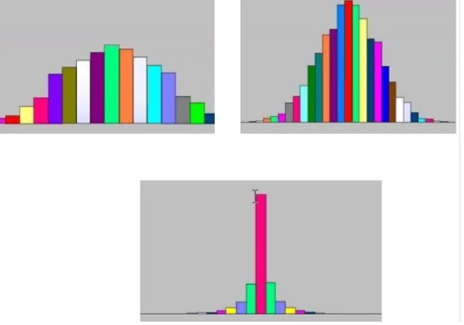
KURTOSIS

Slide 27
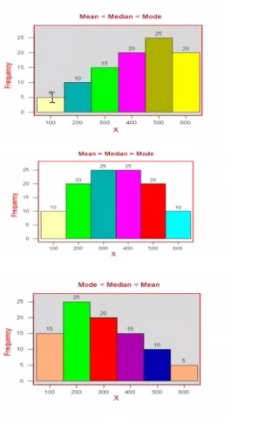
SKEWNESS

