Slide 1
Normal Distribution,
Skewness and Kurtosis

Slide 2
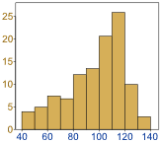
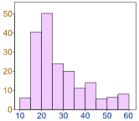
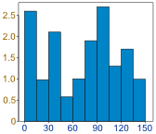
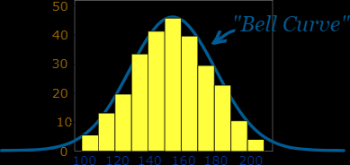

Normal Distribution
Data can be "distributed" (spread out) in different ways.
But there are many cases where the data tends to be around a central value with no bias left or right, and it gets close to a "Normal Distribution" like this:
 | It is often called a "Bell Curve" because it looks like a bell.

Slide 3
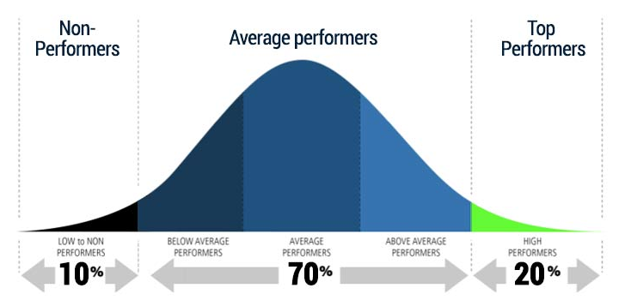
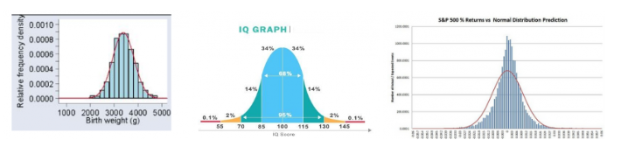

Slide 4
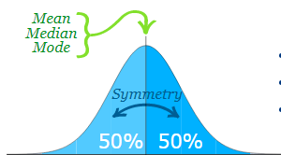
Many things closely follow a Normal Distribution:
heights of people
size of things produced by machines
errors in measurements
blood pressure
marks on a test
We say the data is "normally distributed":
The Normal Distribution has:
mean = median = mode
symmetry about the center
50% of values less than the mean
and 50% greater than the mean

Slide 5
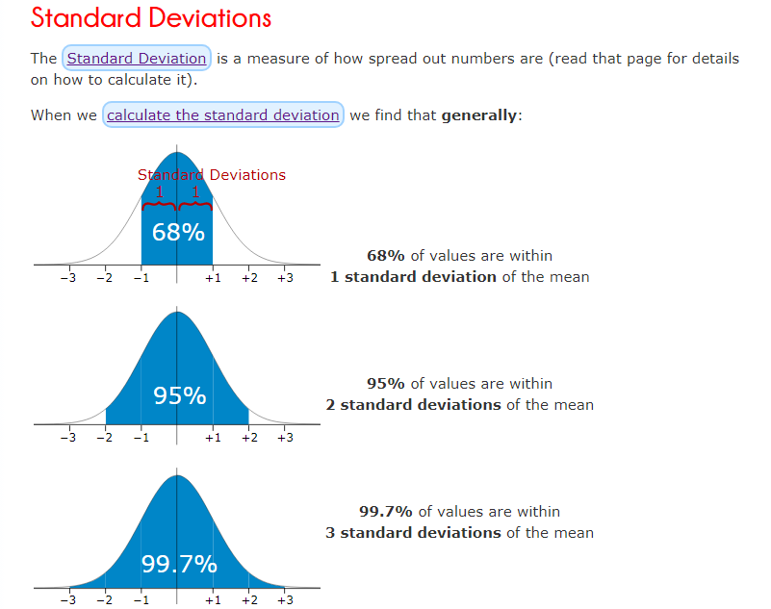

Slide 6
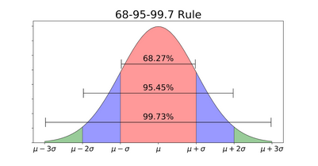
Empirical Rule for Normal Distribution
According to the Empirical Rule for Normal Distribution:
68.27% of data lies within 1 standard deviation of the mean
95.45% of data lies within 2 standard deviations of the mean
99.73% of data lies within 3 standard deviations of the mean
Thus, almost all the data lies within 3 standard deviations.
This rule enables us to check for Outliers and is very helpful when determining the normality of any distribution.

Slide 7

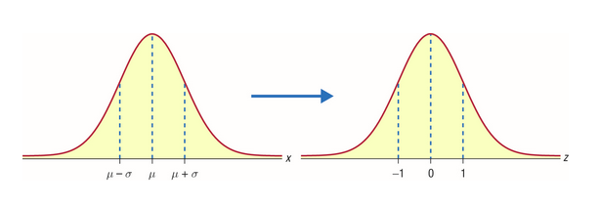
What is a Standard Normal Distribution?
Standard Normal Distribution is a special case of Normal Distribution when 𝜇 = 0 and 𝜎 = 1.
For any Normal distribution, we can convert it into Standard Normal distribution using the formula:

Slide 8
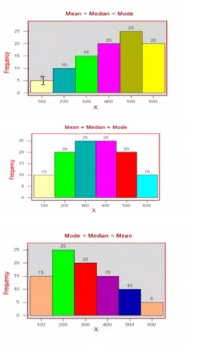
SKEWNESS

Slide 9
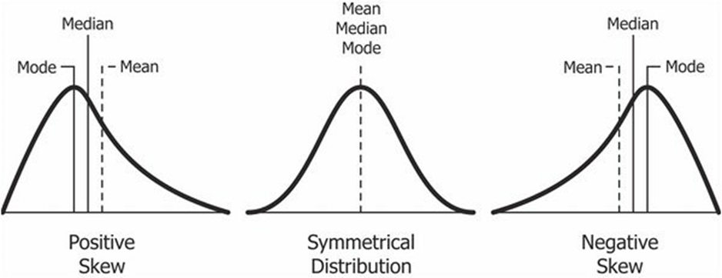
Skewness
It is the degree of distortion from the symmetrical bell curve or the normal distribution. It measures the lack of symmetry in data distribution.
It differentiates extreme values in one versus the other tail. A symmetrical distribution will have a skewness of 0.
There are two types of Skewness: Positive and Negative
Positive Skewness means when the tail on the right side of the distribution is longer. The mean and median will be greater than the mode.
mode < median < mean
Negative Skewness is when the tail of the left side of the distribution is longer or fatter than the tail on the right side. The mean and median will be less than the mode.
mean< median < mode

Slide 10
The rule of thumb seems to be:
If the skewness is between -0.5 and 0.5, the data are fairly symmetrical.
If the skewness is between -1 and -0.5(negatively skewed) or between 0.5 and 1(positively skewed), the data are moderately skewed.
If the skewness is less than -1(negatively skewed) or greater than 1(positively skewed), the data are highly skewed.

Slide 11
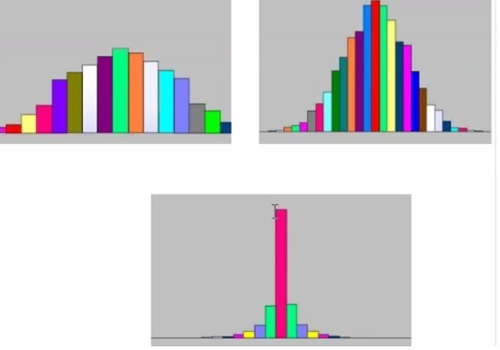
KURTOSIS

Slide 12
Kurtosis
Kurtosis is all about the tails of the distribution —the peakedness or flatness.
It is used to describe the extreme values in one versus the other tail.
It is actually the measure of outliers present in the distribution.
High kurtosis in a data set is an indicator that data has heavy tails or outliers. If there is a high kurtosis, then, we need to investigate why do we have so many outliers. It indicates a lot of things, maybe wrong data entry or other things. Investigate!
Low kurtosis in a data set is an indicator that data has light tails or lack of outliers. If we get low kurtosis(too good to be true), then also we need to investigate and trim the dataset of unwanted results.

Slide 13
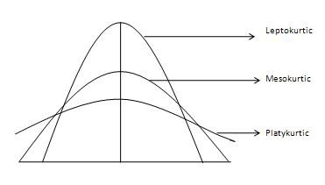
Mesokurtic: This distribution has kurtosis statistic similar to that of the normal distribution. It means that the extreme values of the distribution are similar to that of a normal distribution characteristic. This definition is used so that the standard normal distribution has a kurtosis of three.
Leptokurtic (Kurtosis > 3): Distribution is longer, tails are fatter. Peak is higher and sharper than Mesokurtic, which means that data are heavy-tailed or profusion of outliers.
Outliers stretch the horizontal axis of the histogram graph, which makes the bulk of the data appear in a narrow (“skinny”) vertical range, thereby giving the “skinniness” of a leptokurtic distribution.
Platykurtic: (Kurtosis < 3): Distribution is shorter, tails are thinner than the normal distribution. The peak is lower and broader than Mesokurtic, which means that data are light-tailed or lack of outliers.

Slide 14
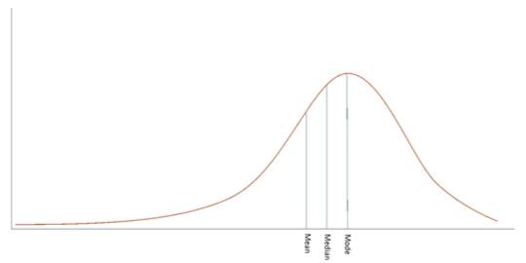
Left Skewed Distribution
When data points cluster on the right side of the distribution, then the tail would be longer on the left side. This is the property of Left Skewed Distribution. The tail is longer in the negative direction so we also call it Negatively Skewed Distribution.
Mode > Median > Mean.
In the Normal Distribution, Mean, Median and Mode are equal but in a negatively skewed distribution, we express the general relationship between the central tendency measured as:
Mode > Median > Mean

Slide 15
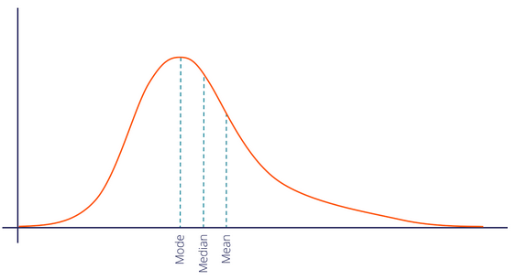
Right Skewed Distribution
When data points cluster on the left side of the distribution, then the tail would be longer on the right side. This is the property of Right Skewed Distribution. Here, the tail is longer in the positive direction so we also call it Positively Skewed Distribution.
In a positively skewed distribution, we express the general relationship between the central tendency measures as:
Mode < Median < Mean

