Slide 1
Scaling the Data

Slide 2
Machine learning models learn a mapping from input variables to an output variable.
As such, the scale and distribution of the data drawn from the domain may be different for each variable.
Input variables may have different units (e.g. feet, kilometers, and hours) that, in turn, may mean the variables have different scales.
Differences in the scales across input variables may increase the difficulty of the problem being modeled. An example of this is that large input values (e.g. a spread of hundreds or thousands of units) can result in a model that learns large weight values.
A model with large weight values is often unstable, meaning that it may suffer from poor performance during learning and sensitivity to input values resulting in higher generalization error.

Slide 3
Numerical Data Scaling Methods
Both normalization and standardization can be achieved using the scikit-learn library.
Data Normalization
Normalization is a rescaling of the data from the original range so that all values are within the new range of 0 and 1.
Normalization requires that you know or are able to accurately estimate the minimum and maximum observable values. You may be able to estimate these values from your available data.
A value is normalized as follows:
y = (x – min) / (max – min)
Where the minimum and maximum values pertain to the value x being normalized.
For example, for a dataset, we could guesstimate the min and max observable values as 30 and -10. We can then normalize any value, like 18.8, as follows:
y = (x – min) / (max – min)
y = (18.8 – (-10)) / (30 – (-10))
y = 28.8 / 40
y = 0.72

Slide 4
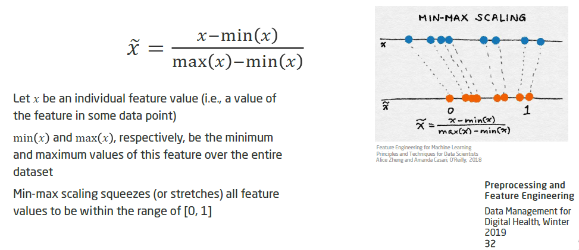

Slide 5
Data Standardization
Standardizing a dataset involves rescaling the distribution of values so that the mean of observed values is 0 and the standard deviation is 1.
This can be thought of as subtracting the mean value or centering the data.
Like normalization, standardization can be useful, and even required in some machine learning algorithms when your data has input values with differing scales.
Standardization assumes that your observations fit a Gaussian distribution (bell curve) with a well-behaved mean and standard deviation. You can still standardize your data if this expectation is not met, but you may not get reliable results.
Subtracting the mean from the data is called centering, whereas dividing by the standard deviation is called scaling. As such, the method is sometime called “center scaling“.

Slide 6
A value is standardized as follows:
y = (x – mean) / standard_deviation
Where the mean is calculated as:
mean = sum(x) / count(x)
And the standard_deviation is calculated as:
standard_deviation = sqrt( sum( (x – mean)^2 ) / count(x))
We can guesstimate a mean of 10.0 and a standard deviation of about 5.0. Using these values, we can standardize the first value of 20.7 as follows:
y = (x – mean) / standard_deviation
y = (20.7 – 10) / 5
y = (10.7) / 5
y = 2.14
Note : The mean and standard deviation estimates of a dataset can be more robust to new data than the minimum and maximum.

Slide 7
