Slide 1
KNN Algorithm
@Machine Learning
#Data Science

Slide 2
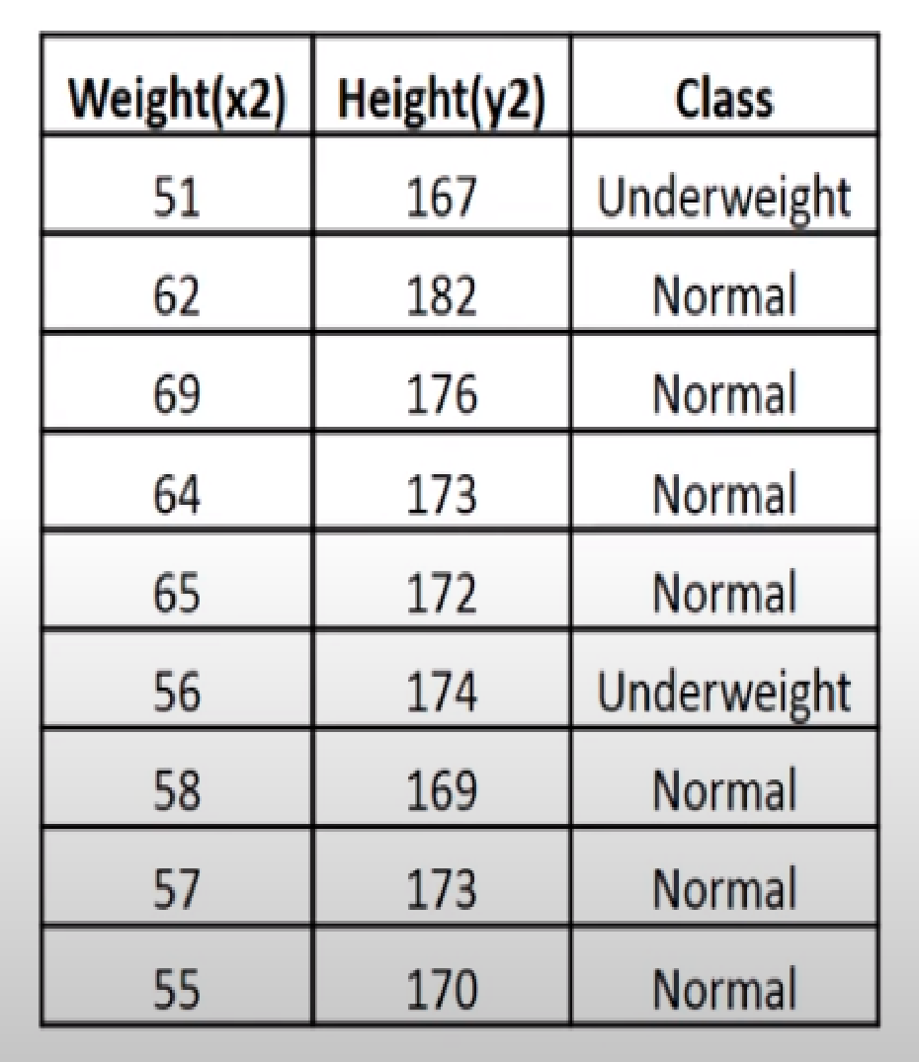
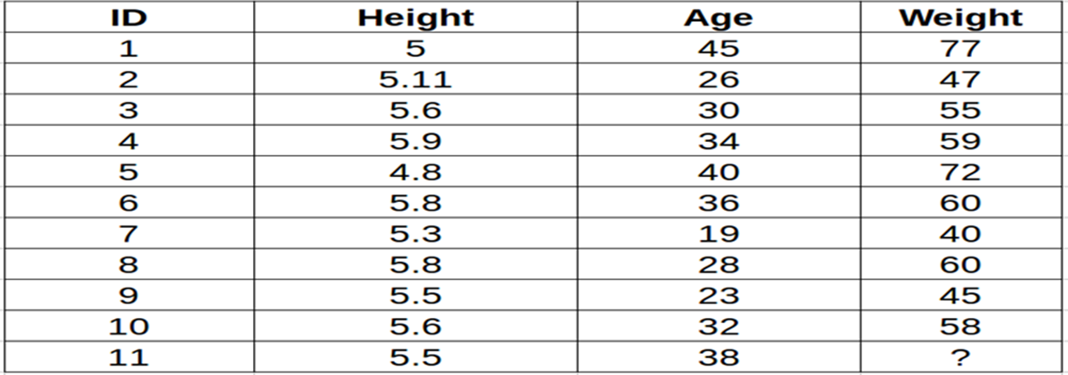
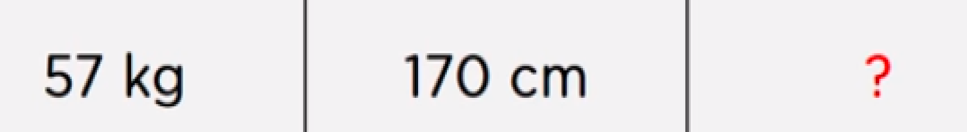
Classification Regression

Slide 3
KNN Algorithm is one of the simplest but strong supervised Machine Learning algorithm.
KNN can be used for both classification and regression problems.
The output depends on whether you use the KNN algorithm for classification or regression.
It collects data from a training data set, and uses this data later to make predictions for new records.
For each new record, the k-closest records of the training data set are determined.
Based on the value of the target attribute of the closest records, a prediction is made for the new record.
The KNN algorithm uses ‘feature similarity’ to predict the values of any new data points.
This means that the new point is assigned a value based on how closely it resembles the points in the training set.

Slide 4
KNN For Classification
KNN algorithm for classification uses a “Majority Voting” mechanism.
The predicted class label is determined by the voting for the nearest neighbors, that is, the majority class label in the set of the selected k instances is returned.
KNN For Regression
In KNN regression, the average value of the target function values of the nearest neighbors is returned as the predicted value.

Slide 5
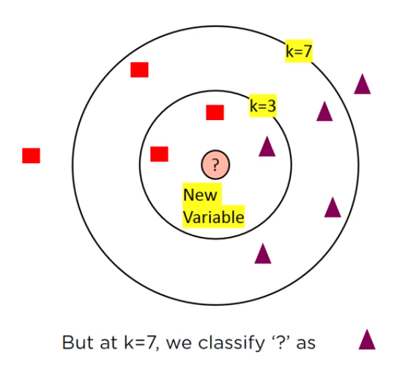
Anatomy of k-Nearest Neighbors
k in kNN is a parameter that refers to the number of Nearest Neighbors to include in the majority voting process(Classification)or average(Regression).
For instance ,in classification if k=7 the data point is classified by majority votes from its 7 nearest neighbors.

Slide 6
Choosing k
As we know kNN is based of feature similarity, choosing the right k value is a process called parameter tuning, which is very important for best accuracy
-------------What if k is Too High or Too Low------------
For a very low value of k (suppose k=1), the model overfits on the training data, which leads to a high error rate on the validation set.
On the other hand, for a high value of k, the model performs poorly on both train and validation set. (Underfitting)

Slide 7
Right k value selection
Use sqrt(n) ;n -> total number of data points.
Odd value should be selected
We can use Cross-validation techniques for choosing right k.

Slide 8
When to Use k-NN
When Data is labelled.
When DataSet is small, since kNN is said to be a Lazy Learner.
When Data is Noise free i.e., too many labels

Slide 9
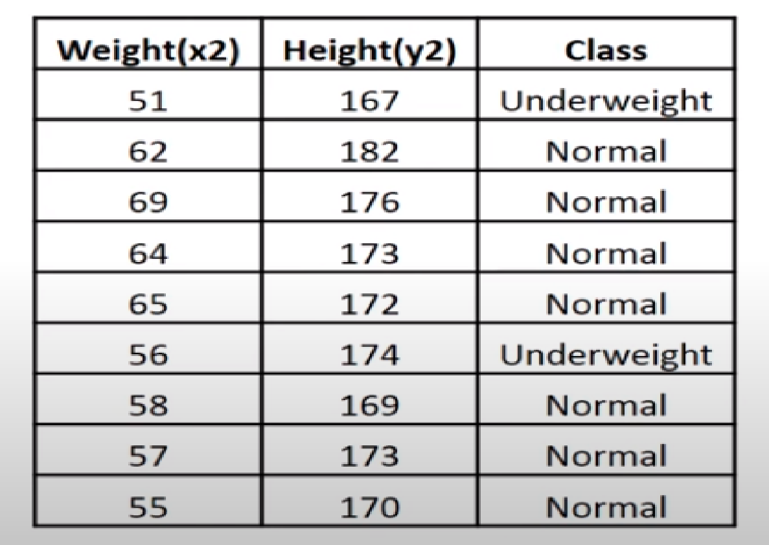
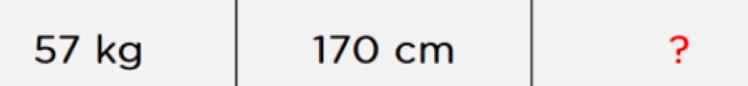

Slide 10
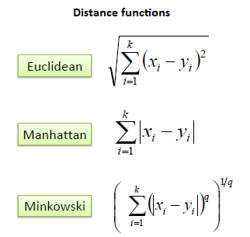
Math Behind k-NN
(for continuous)

Slide 11
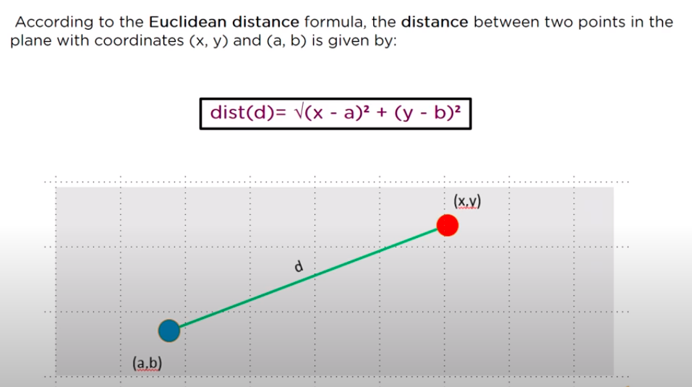
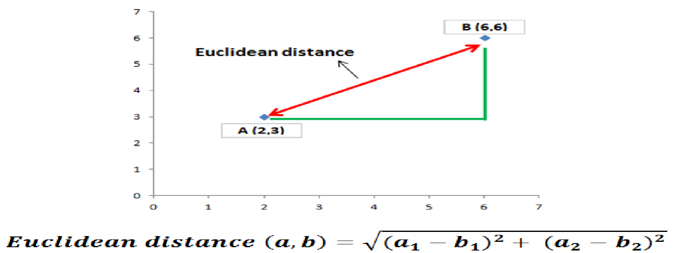

Slide 12
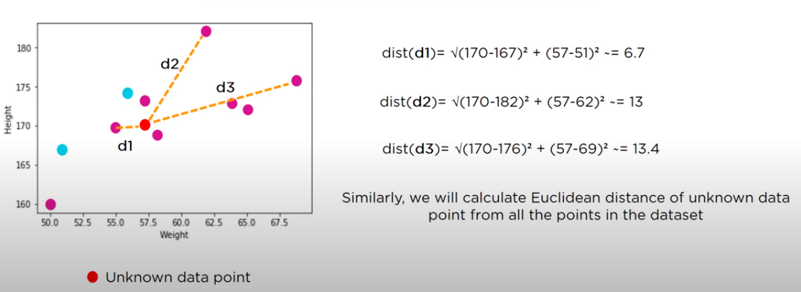
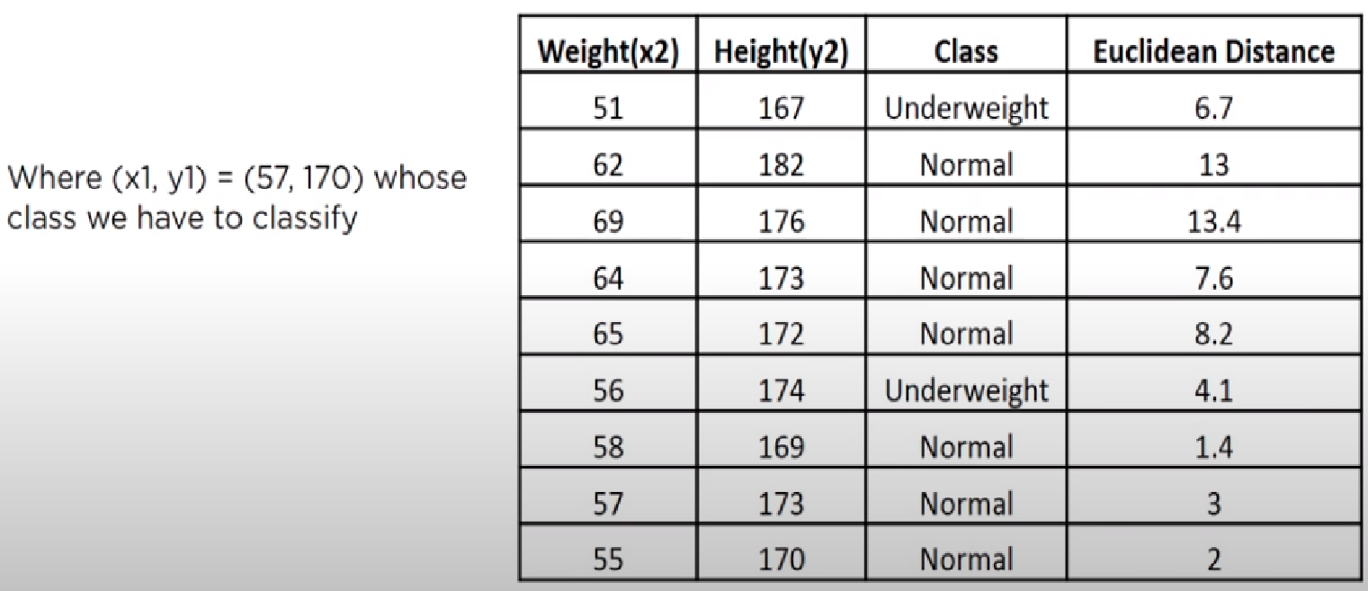

Slide 13
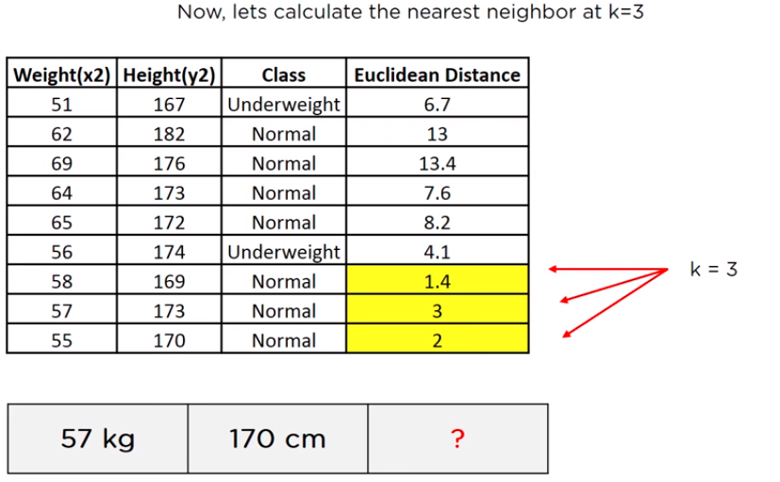
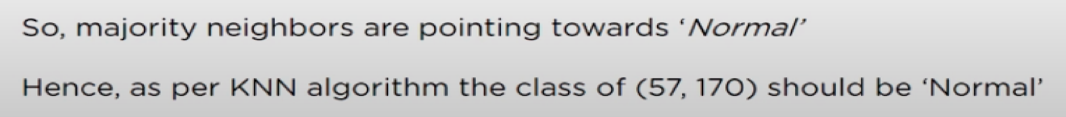

Slide 14

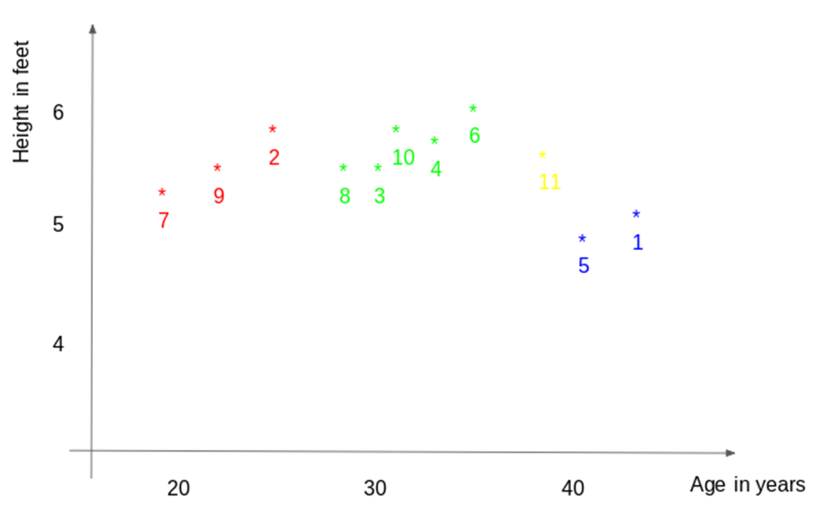
k-NN Algorithm for Regression

Slide 15
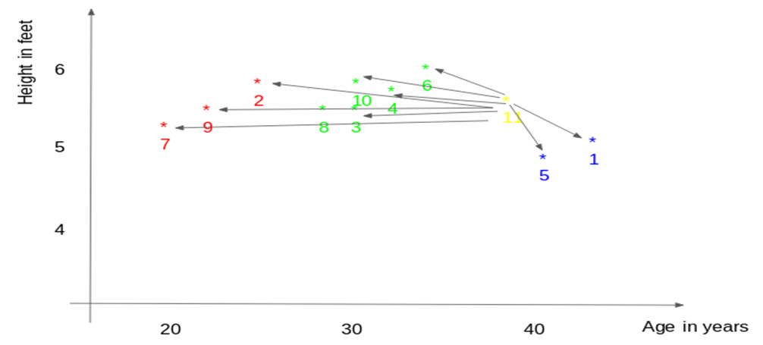
1. First, the distance between the new point and each training point is calculated.

Slide 16
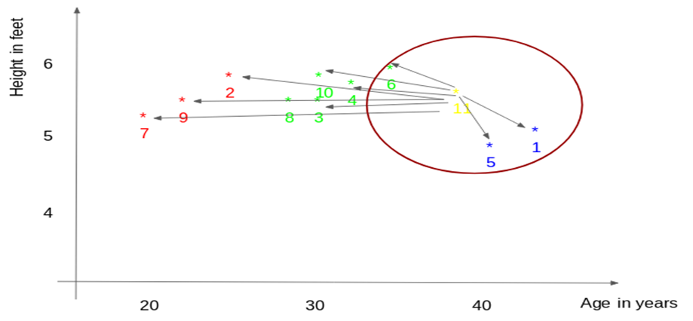
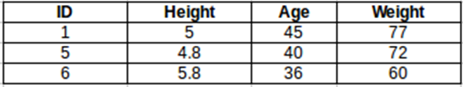
2. The closest k data points are selected (based on the distance).
In this example, points 1, 5, 6 will be selected if the value of k is 3.
The average of these data points is the final prediction for the new point.
Here, we have weight of ID11 =
(77+72+60)/3 = 69.66 kg.

Slide 17
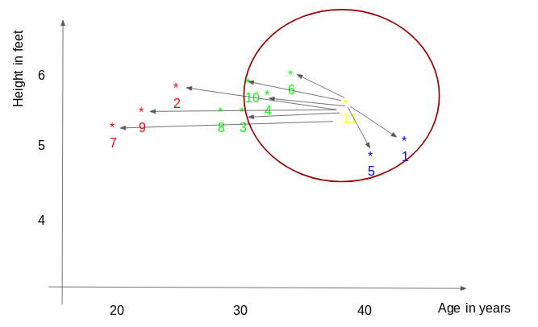
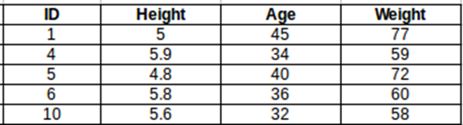
The prediction for ID11 will be :
ID 11 = (77+59+72+60+58)/5
ID 11 = 65.2 kg

Slide 18
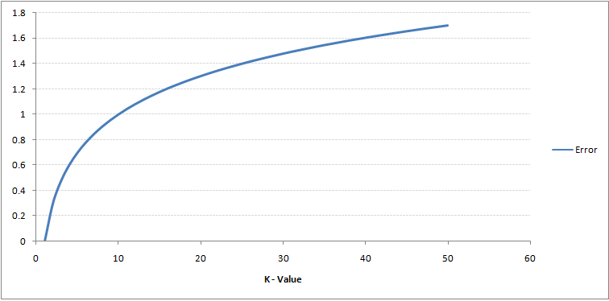
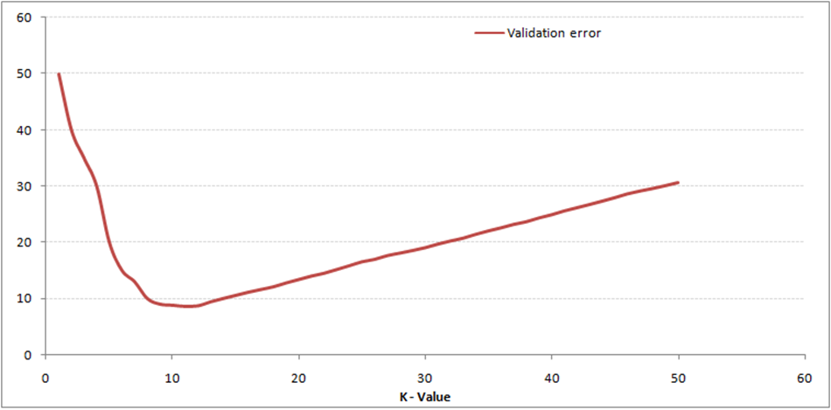
If you observe closely, the validation error curve reaches a minima at a value of k = 9. This value of k is the optimum value of the model (it will vary for different datasets).
This curve is known as an ‘elbow curve‘ (because it has a shape like an elbow) and is usually used to determine the k value.

Slide 19
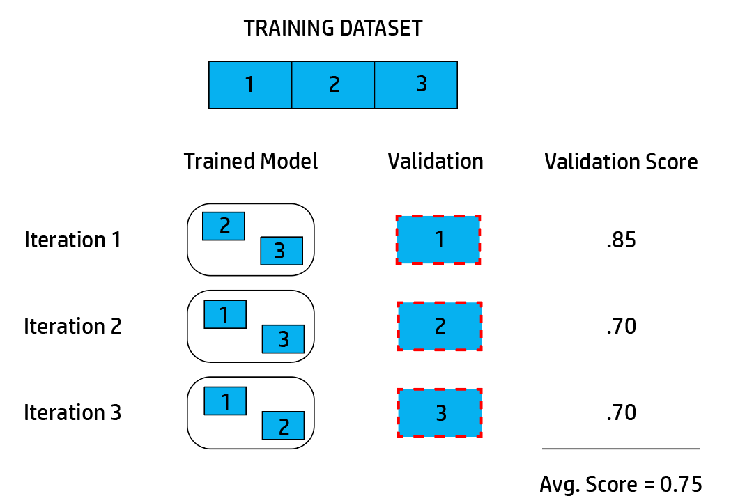

Slide 20
O - Obtaining our data
S - Scrubbing / Cleaning our data
E - Exploring / Visualizing our data will allow us to find patterns and trends
M - Modeling our data will give us our predictive power as a wizard
N - INterpreting our data

